Slide 1

Data Warehouse Wars
Katowice 2020.02.27
Tomasz Krawczyk

Slide 2
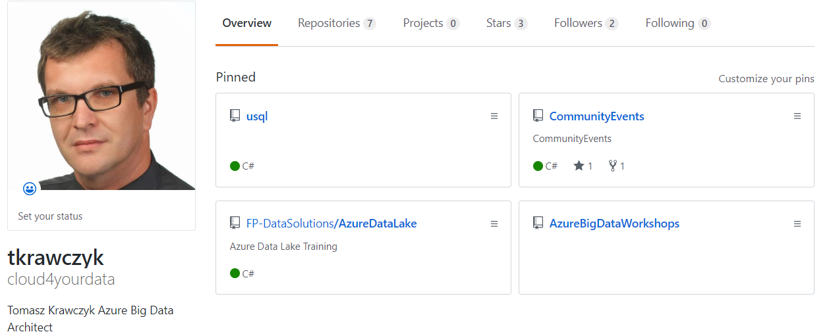

https://github.com/cloud4yourdata/CommunityEvents

Slide 3
Agenda
Real challenges
Azure Data Solutions
Modern Data Warehouse (Lakehouse)
Snowflake vs Azure Synapase
Demo(s)
Q&A

Slide 4
Real challenges
How to build a “warehouse” in the cloud (Azure) ?
How to choose proper DW engine?
SMP vs MPP solutions?
Data lake or Data warehouse ?
ELT/ETL processes in the cloud?
Notes:
Jesli chodzi o przetwarzanie duzych zbiorow danych to ostatnio staje sie popularne podejscie przewtarzania oparte o Data Lake.
Koncepcja ta bardzo mocno wpisuje się w architektura Lambda w process przetwarzania COLD Data
Czym jest Data Lake ? CTO Pentaho James Dixon zdefiniowal data lake w nastepujacy sposob : jesli DW to magazyn z woda to DL do woda w naturalnej postaci
Jest jeszcze jedna definicja DL – to ISASA –czyli skrot od Ingest Store Analyse Surface Act
Z binesowego punktu widzenia najwazniejszy jest ACT –czy Make Me More Money
Najogolniej mowiac DL to konetener na roznego rodzaju dane – wrzucamy tam dowolne dane I przetwarzamy jest w zaleznosci od potrzeb

Slide 5
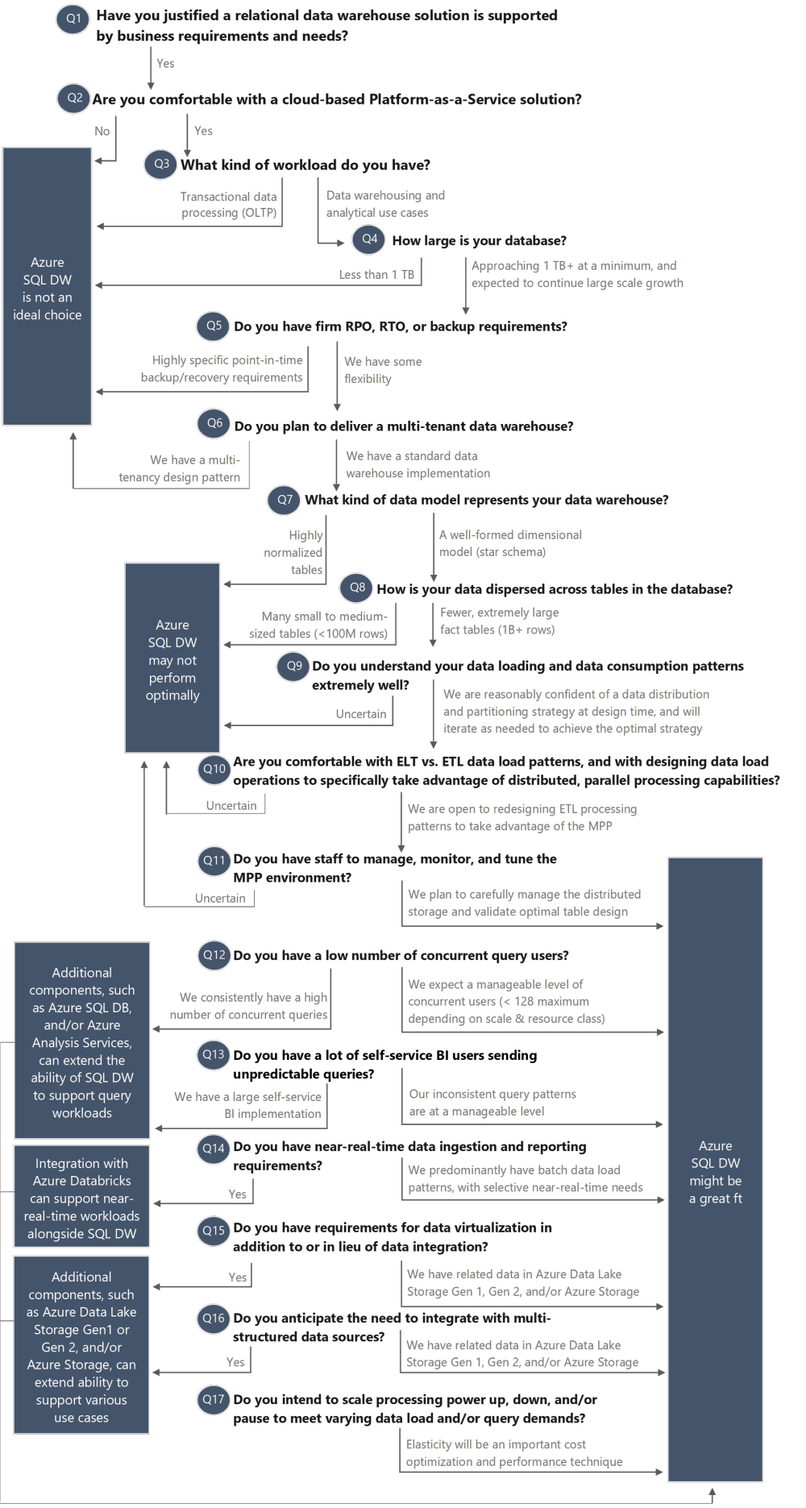
List of questions
What will be estimated data volume?
What will be daily (monthly, annual) data increment?
How many concurrent queries should be supported by the solution?
What kind of data will be stored/processed (structured, semistructured e.g. json, xml etc.)?
What kind of operations will be executed on the client's site (e.g. fast lookups or complex queries, OLTP or OLAP)?
What kind of data sources should be handled?
Are cloud-based solutions accepted? If yes , what is the accepted monthly cost?
Do we build a modern data warehouse based on data lake approach?
Are there any additional requirements or recommendations regarding the db engines? (e.g Open Source)?
Source:https://www.blue-granite.com/blog/is-azure-sql-data-warehouse-a-good-fit-updated

Slide 6




SMP vs MPP Architecture
Symmetric Multi Processing
Massively Parallel Processing
A-F
G-K
L-P
Q-Z
A-Z
Coupled Compute and Storage
Compute
A-F
G-K
L-P
Q-Z
Decoupled Compute and Storage

Slide 7









Azure Data Solutions
Symmetric Multi Processing
Massively Parallel Processing
Azure Database for
PostgreSQL (Citus)
Azure Synapse Analytics
Snowflake
Azure SQL Database
Azure Database for PostgreSQL
Azure Database for MariaDB
Azure Database for MySQL
Azure Data Explorer
Azure Databricks
Azure HDInsight Interactive
Query Cluster

Slide 8
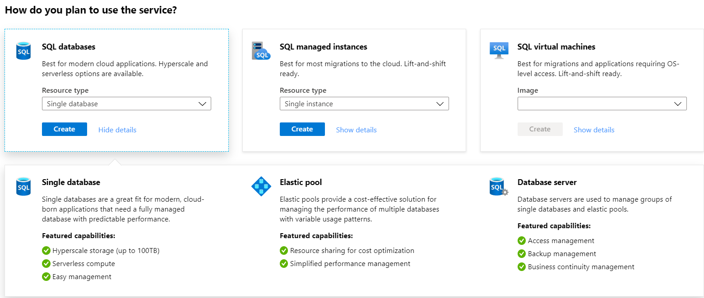
Azure SQL Databases
Notes:
Azure SQL Database has the following deployment options:
• Single
• Elastic pool
• Managed instance

Slide 9
Azure SQL Databases
General purpose
Deployment:
Single/Elastic Pools
Management Instance
Compute tiers
Single/Elastic Pools
Gen4: 1-24 /Gen5: 2-80 vCore
Serverless:1-16 vCore
Managed Instance
Gen4: 4-24 /Gen5 4-80 vCore
Storage (Premium remote)
Single/Elastic Pools
Max 4 TB (per instance)
Managed Instance
Max 8 TB (per instance)
IO : ~2ms for all data access
Replicas : 2 read replicas
Backups: RA-GRS
Usage: Limited costs
Business critical
Deployment:
Single/Elastic Pools
Management Instance
Compute tiers
Single/Elastic Pools
Gen4: 1-24 /Gen5: 2-80 vCore
Serverless:1-16 vCore
Managed Instance
Gen4: 4-24 /Gen5 4-80 vCore
Storage (Local SSD)
Single/Elastic Pools
Max 4 TB (per instance)
Managed Instance
Max 8 TB (per instance)
IO : <0.5ms for all data access
Replicas : 3 replicas/ 1 read scale replica, zone redundant
Backups: RA-GRS
Usage: Critical business application with hight IO requirements
Hyperscale
Deployment:
Single
Compute tiers
Single/Elastic Pools
Gen4: 1-24 /Gen5: 2-80 vCore
Storage (Local SSD Cache)
Single/Elastic Pools
Up to 100 TB (per instance)
IO : <0.5ms hot data and ~2ms other data
Replicas : 1 read/write+ up to 4 read replicas
Backups: LRS/ZRS,RA-GRS
Usage: OLTP with hight scalable storage and read scale requirements

Slide 10
Azure SQL DTU vs vCore and Gen4 vs Gen5
DTU vs vCore
100 Standard tier DTU = 1 vCore General Purpose tier
125 Premium tier DTU = 1 vCore Business Critical tier
Azure SQL Database DTU Calculator
https://dtucalculator.azurewebsites.net/
Gen4 vs Gen5
Gen4 offers up 24 logical CPUs, based on Intel E5-2673 v3 (Haswell) and 2.4 GHz processors, with 7 GB memory per core and attached SSD. Gen4 offers more memory per core.
Gen5 offers up to 80 logical CPUs, based on Intel E5-2573 v4 (Broadwell) and 2.3 GHz processors, with 5.1 GB per core and fast eNVM SSD. Gen5 offers more compute scalability with 80 logical CPUs.

Slide 11
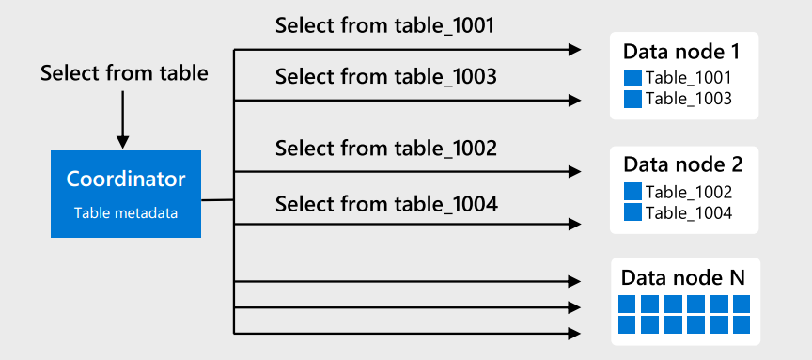
Azure PostgreSQL and Citus
Azure Database for PostgreSQL is a relational database service in the Microsoft cloud
built for developers. It is based on the community version of open-source PostgreSQL database engine,
and is available in two deployment options: Single Server and Hyperscale (Citus).
The Hyperscale (Citus) option horizontally scales queries across multiple machines using sharding. Its query engine parallelizes incoming SQL queries across these servers for faster responses on large datasets.
Source: https://docs.microsoft.com/en-us/azure/postgresql/overview
Notes:
Vcore Model

Slide 12
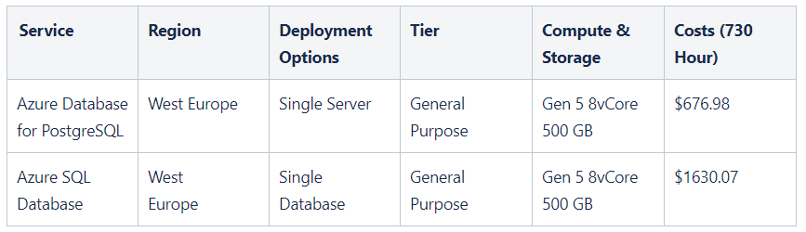
Azure SQL Database vs PostgreSQL

Slide 13
DEMO
https://azure.microsoft.com/en-us/pricing/calculator/
Azure Database for PostgreSQL

Slide 14
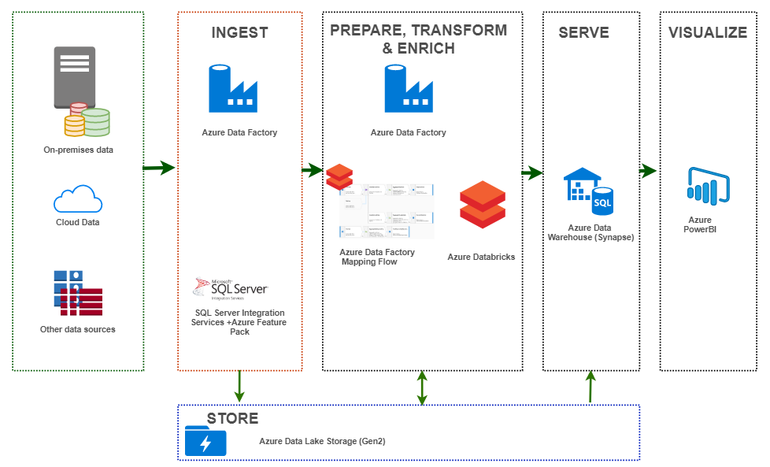
Modern Data Warehouse

Slide 15
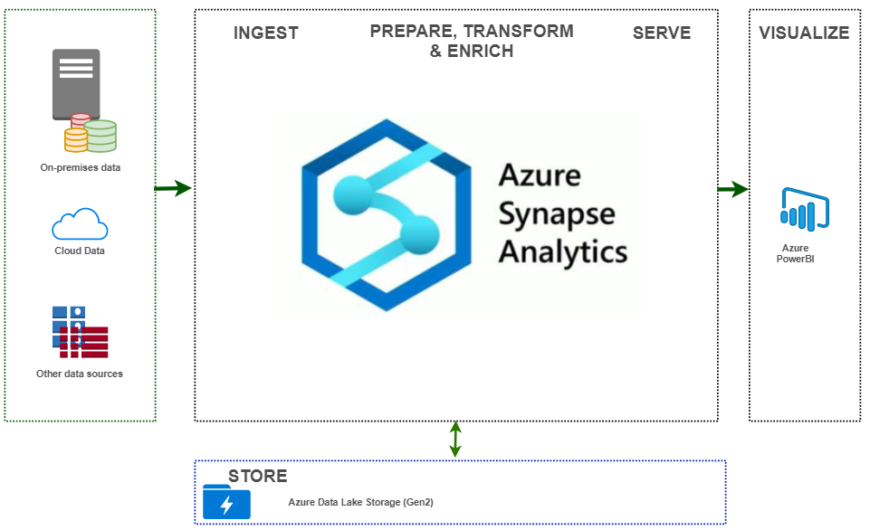
Modern Data Warehouse and Azure Synapse

Slide 16
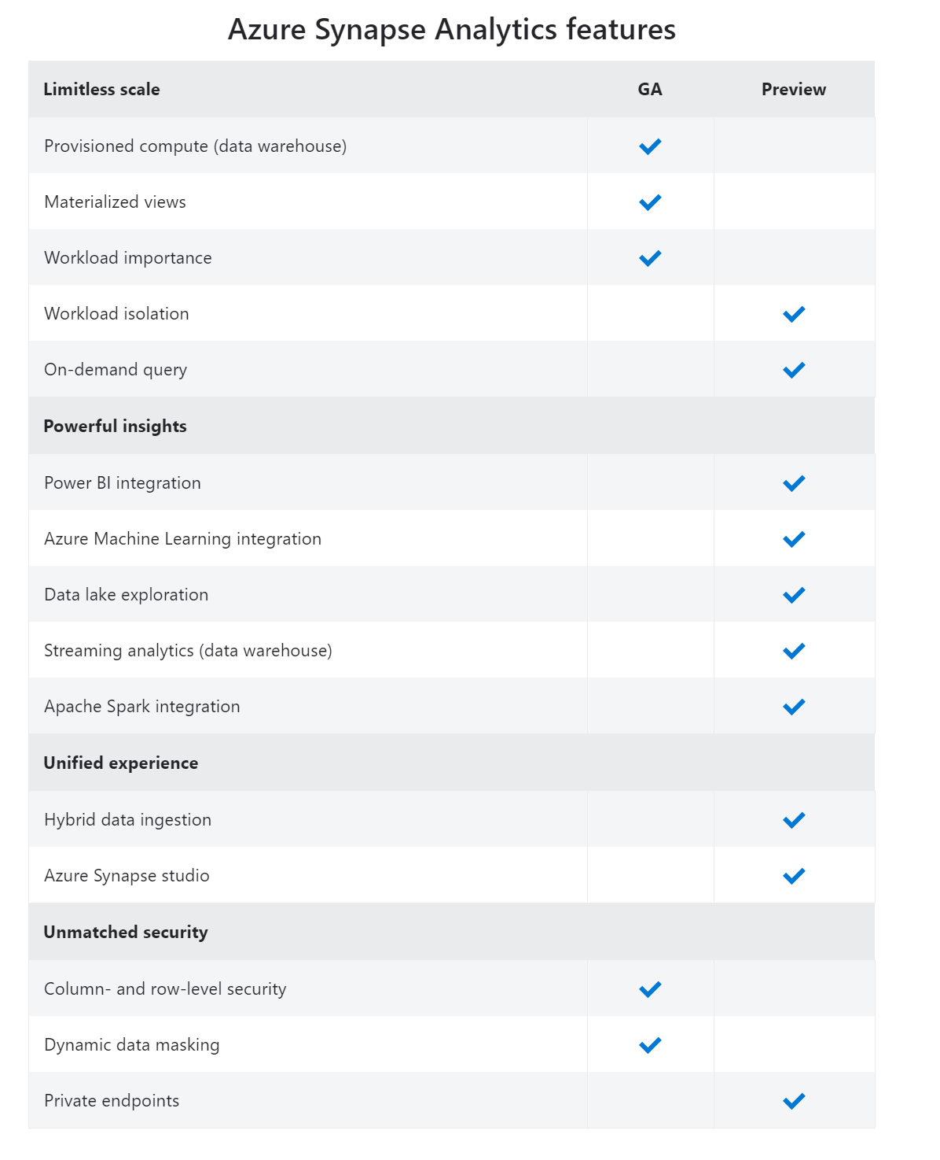
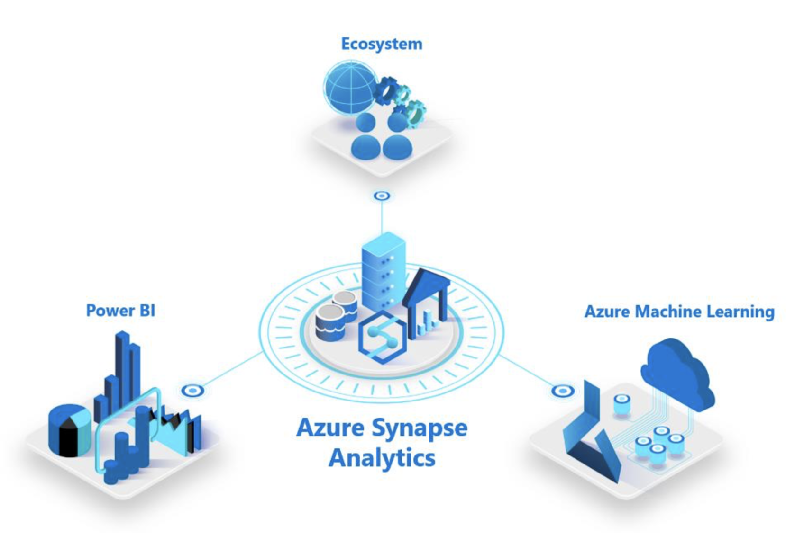
Azure Sypanse
Azure Synapse is a limitless analytics service that brings together enterprise data warehousing and Big Data analytics.

Slide 17
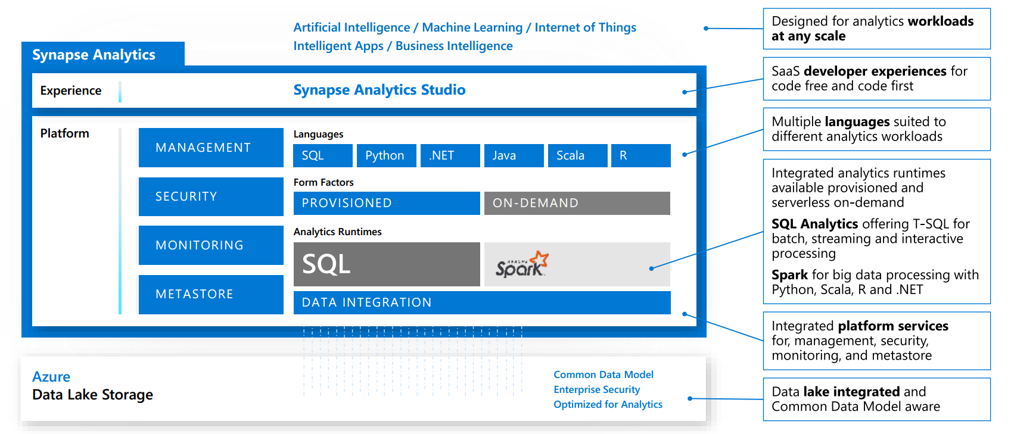

Slide 18
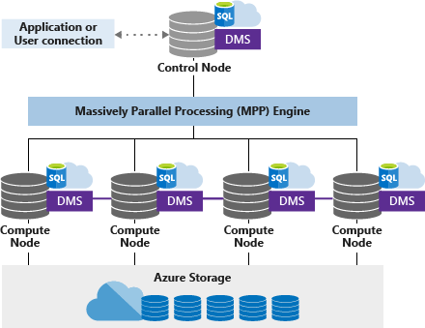
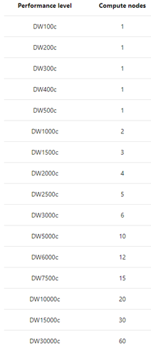
Azure Synapse Analytics Architecture
Data is distributed across 60 distributed databases.

Slide 19
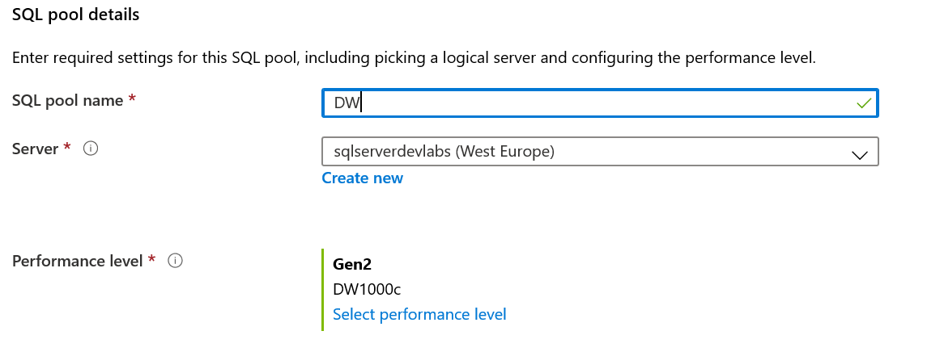
Azure Synapse Analytics
Create an Azure SQL Server
Create SQL Pool (SQL Data Warehouse)
Define Performance Level
Create Firewall Rule(*)
Data Loading
PolyBase (supported by Azure Data Factory)
External Data Source
External File Format
External Table
Create a dedicated load user account
Workload Classification – To assign a request to a workload group and setting importance levels.
Workload Importance – To influence the order in which a request gets access to resources.
Workload Isolation – To reserve resources for a workload group
Manage your files
Create statistics after loading
Notes:
Resource classes static I dynamic
Workload classification Overview Map queries to allocations of resources via pre-determined rules. Use with workload importance to effectively share resources across different workload types. If a query request is not matched to a classifier, it is assigned to the default workload group (smallrc resource class) State analysts have normal importance. National analyst is assigned high importance. State analyst queries execute in order of arrival When the national analyst’s query arrives, it jumps to the top of the queue

Slide 20
Azure Synapse -Table
CREATE TABLE orderTable
(
OrderId INT NOT NULL,
[Date] DATE NOT NULL,
[Name] VARCHAR(2),
Country VARCHAR(2)
)
WITH
(
CLUSTERED COLUMNSTORE INDEX /*ORDER (OrderId)
--Ordered Clustered Columnstore Index */
/* HEAP | CLUSTERED INDEX (OrderId)*/,
DISTRIBUTION = HASH([OrderId]) |
/* ROUND ROBIN | REPLICATE*/
PARTITION (
[Date] RANGE RIGHT FOR VALUES (
'2000-01-01', '2001-01-01', '2002-01-01',
'2003-01-01', '2004-01-01', '2005-01-01'
)
)
);
Round-robin distributed
Distributes table rows evenly across all distributions
at random.
Hash distributed
Distributes table rows across the Compute nodes by
using a deterministic hash function to assign each
row to one distribution.
Replicated
Full copy of table accessible on each Compute node

Slide 21
DEMO
Azure Synapse Analytics
(Azure Portal + SSMS)

Slide 22
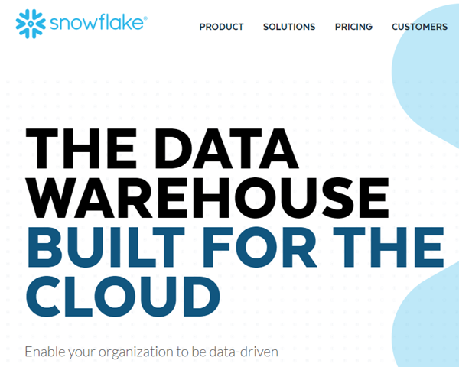
Snowflake DW
Snowflake is an analytic data warehouse provided as Software-as-a-Service (SaaS). Snowflake provides a data warehouse that is faster, easier to use, and far more flexible than traditional data warehouse offerings.
Unique Offerings
Scalability (Storage and Compute)
No complex management (performance)
No indexing
No performance tuning
No partitioning
No Physical Storage Design
https://docs.snowflake.net/manuals/user-guide/intro-key-concepts.html

Slide 23
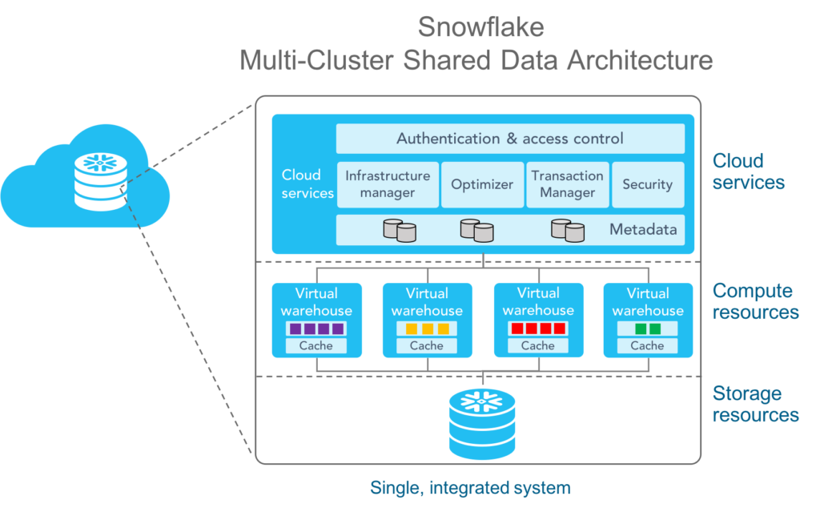
Snowflake Architecture
https://www.snowflake.com/blog/5-reasons-to-love-snowflakes-architecture-for-your-data-warehouse/

Slide 24
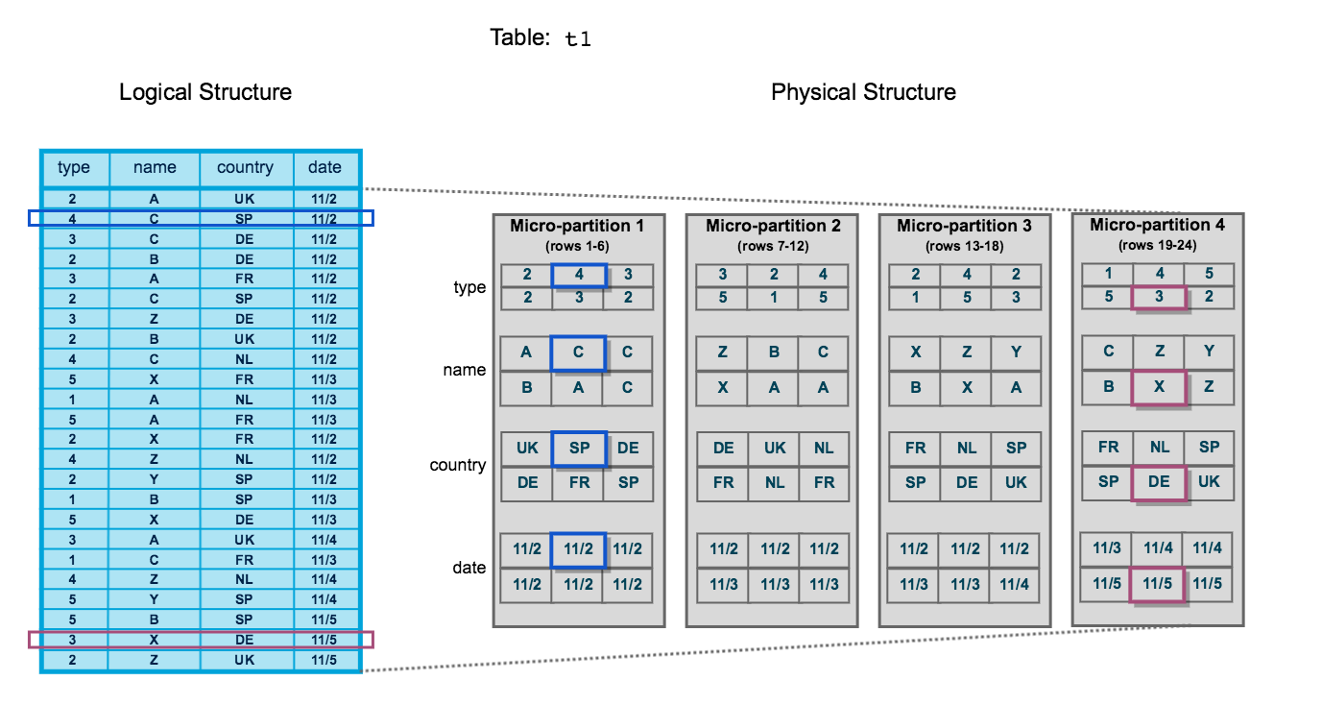
Snowflake Architecture -Storage
Snowflake automatically converts all data stored into an optimized immutable compressed columnar format (Micro-Partitions –one partition contains 50M -500MB uncompressed data) and encrypts it using AES-256 strong encryption.
Partition Metadata:
The range of values for each of the columns in the micro-partition.
The number of distinct values.
Additional properties used for both optimization and efficient query processing.
https://docs.snowflake.net/manuals/user-guide/tables-clustering-micropartitions.html#what-are-micro-partitions

Slide 25
Snowflake Architecture -Compute
Snowflake processes queries using “virtual warehouses”. Virtual warehouses are one or more clusters of servers that provide compute resources.
Scale up
T-Shirt Sizing
Warehouse Size | Server per Cluster | Credit per Hour | Notes
X-Small | 1 | 1 | Default size for warehouses created in SQL using CREATE.
Small | 2 | 2
Medium | 4 | 4
Large | 8 | 8
X-Large | 16 | 16 | Default size for warehouses created in the UI.
2X-Large | 32 | 32
3X-Large | 64 | 64
4X-Large | 128 | 128
Scale out (x10)
Autoscaling

Slide 26
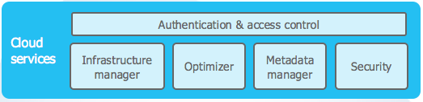
Snowflake Architecture – Cloud Services
The cloud services layer is a collection of services that coordinate activities across Snowflake .
Notes:
Nie placimy ze nie
Pewne operacje sa wykonywane tylko przez cloud services

Slide 27

Snowflake - Features
Pay as you use
Azure/AWS/GCP (hosting environment)
Azure/AWS integration (stage, snowpipe, ..)
ODBC/JDBC support
Scale up/out (online)
Zero Cloning Copy
Time Travel
Result Caching
Data sharing
Security (RBAC, Data encryption)
Semi-structured data support
SQL (Merge, Copy Into, Materialized view, SP)
External Tables

Slide 28
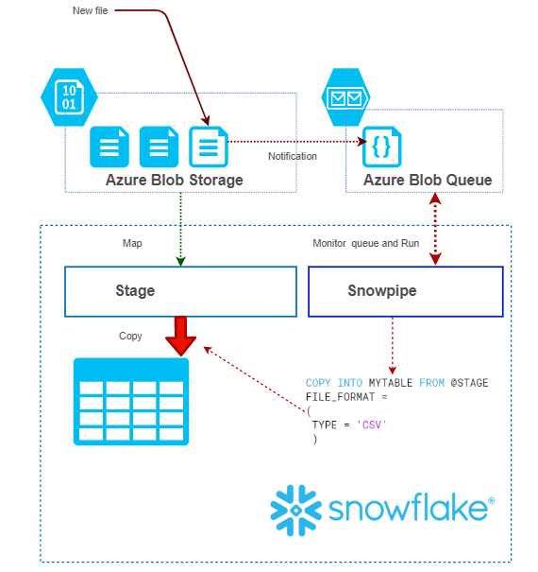
Snowflake ETL(s) with Azure
Loading Continuously Using Snowpipe
Snowpipe is Snowflake’s continuous data ingestion service. Snowpipe loads data within minutes after files are added to a stage and submitted for ingestion.
Typical scenario (Loading IoT Data)
IoTHub -> Azure Blob Storage (Routing) -> Snowflake
Event Hub ->Azure Blob Storage (Routing) -> Snowflake

Slide 29
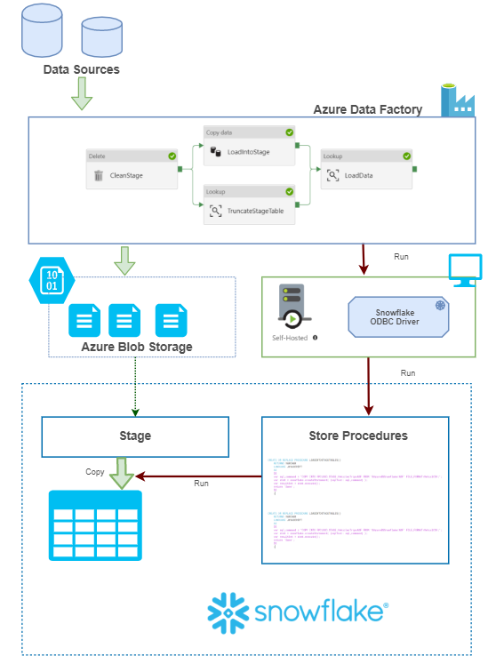
Snowflake ETL(s) with Azure
Bulk Loading Using COPY and Azure Data Factory
COPY INTO <table> - loads data from staged files to an existing table.
Steps:
Create Stage
Create File Format
Create Table
Create Storage Procedure (*)
Run Store Procedure(*) via ODBC

Slide 30
DEMO
Snowflake

Slide 31
Synapse vs Snowflake
Azure Synapse Analytics
Snowflake DW
Hosting environment : Azure
Azure integration : Native (Azure Data Factory)
Scale out : Offline (via PowerShell, TSQL)
Connectivity : SQL/TDS
Zero Cloning Copy : No
Time travel : No
Result Caching : Yes (Doesn't use slots)
Data sharing : Yes
Security : RBAC, Data Encryption
External tables : Yes
Workload isolation : Yes(resource classes/group)
On-demand query: Yes**
Power BI integration: Native*
Hosting environment : Azure, AWS, GCP
Azure integration : Azure Blob Storage, Azure Data Factory ODBC, Snowpipes (*)
Scale out : Online (Autoscaling)
Connectivity : ODBC/JDBC
Zero Cloning Copy : Yes
Time travel : Yes (90 days)
Result Caching : Yes
Data sharing : Yes
Security : RBAC, Data Encryption
External tables : Yes
Workload isolation : Yes(Virtual Warehouses)
On-demand query: Yes*(starts DW and turns off)
Power BI integration: Yes*

Slide 32
Synapse vs Snowflake
Azure Synapse Analytics
Snowflake DW
Azure Machine Learning integration: Native**
Data lake exploration: Native **
Apache Spark integration: Native **
Data Factory Integration : Native **
Dynamic data masking: Yes
Semi-structured data support: Yes*
Network isolation: Private endpoints and Firewall
Data Streaming Ingestion: Yes**
Data Management Complexity: Complex (Indexes, Distribution, Partitioning, Replicated tables)
Pricing Model: PAY AS YOU GO (Start and Stop DW “manually”)
Azure Machine Learning integration: No*
Data lake exploration: Azure Blob Storage /Lake Gen2 (Multi Protocol)
Apache Spark integration: Yes*
Data Factory Integration : Yes (ODBC) *
Dynamic data masking: No* (Secured view)
Semi-structured data support: Yes
Network isolation: Firewall
Data Streaming Support: No (Snowpipe)
Data Management Complexity: No
Pricing Model: PAY AS YOU GO (Compute engine starts via ODBC/JDBC and this operation takes a few seconds)

Slide 33
Q & A

Slide 34
Resources
My examples (and demos)
https://github.com/cloud4yourdata/CommunityEvents/tree/master/DC_2020_DWWars
Blogs,pages,documentation, articles
https://docs.microsoft.com/en-us/azure/sql-database/
https://docs.microsoft.com/en-us/azure/postgresql/
https://docs.microsoft.com/en-us/azure/sql-data-warehouse/
https://docs.snowflake.net/manuals/index.html

Slide 35
THANK YOU!
tkrawczyk@future-processing.com

